Slide 1
AIOT Final Project
Image Classification

Slide 2
Table of contents
01
02
03
04
Introduction
Collect data
Model training process
Build on Arduino IDE

Slide 3
01
Introduction

Slide 4
Project Idea Objective
- Develop a model that can classify images into two categories: "Vehicles" (cars, trucks, motorbikes, etc.) and "Non-vehicles" (pedestrians, animals, bicycles, etc.).
- Below is the application when applying this project:
Traffic monitoring system: Classify objects detected by cameras as vehicles or non-vehicles for traffic analysis.
Autonomous vehicles: Enhance the object detection system by filtering out non-vehicle objects.
Security monitoring: Automatically detect vehicles in security footage to monitor parking lots or restricted areas.

Slide 5
02
Collect data

Slide 6


Dataset
https://www.kaggle.com/datasets/brsdincer/vehicle-detection-image-set
Non-vehicles
Vehicles

Slide 7
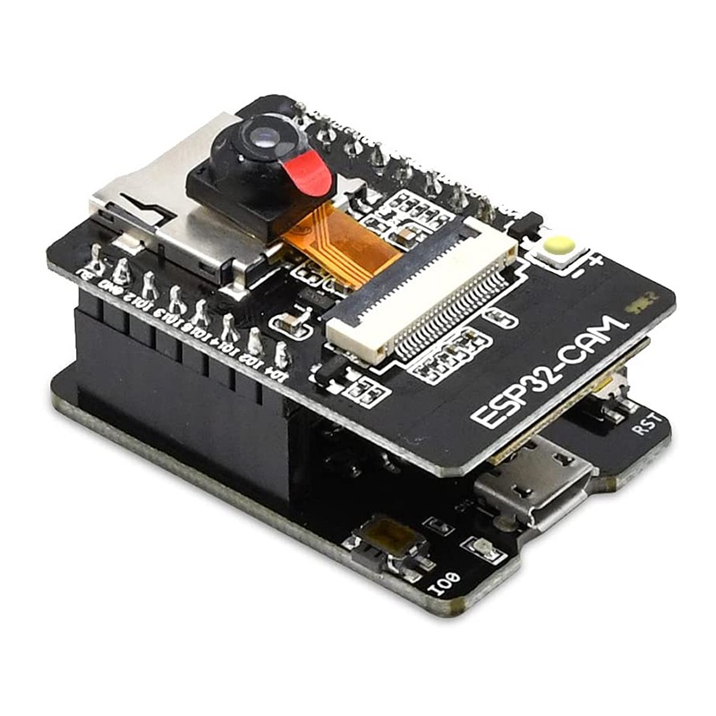
Devices
ESP32-CAM

Slide 8
03
Model training process

Slide 9
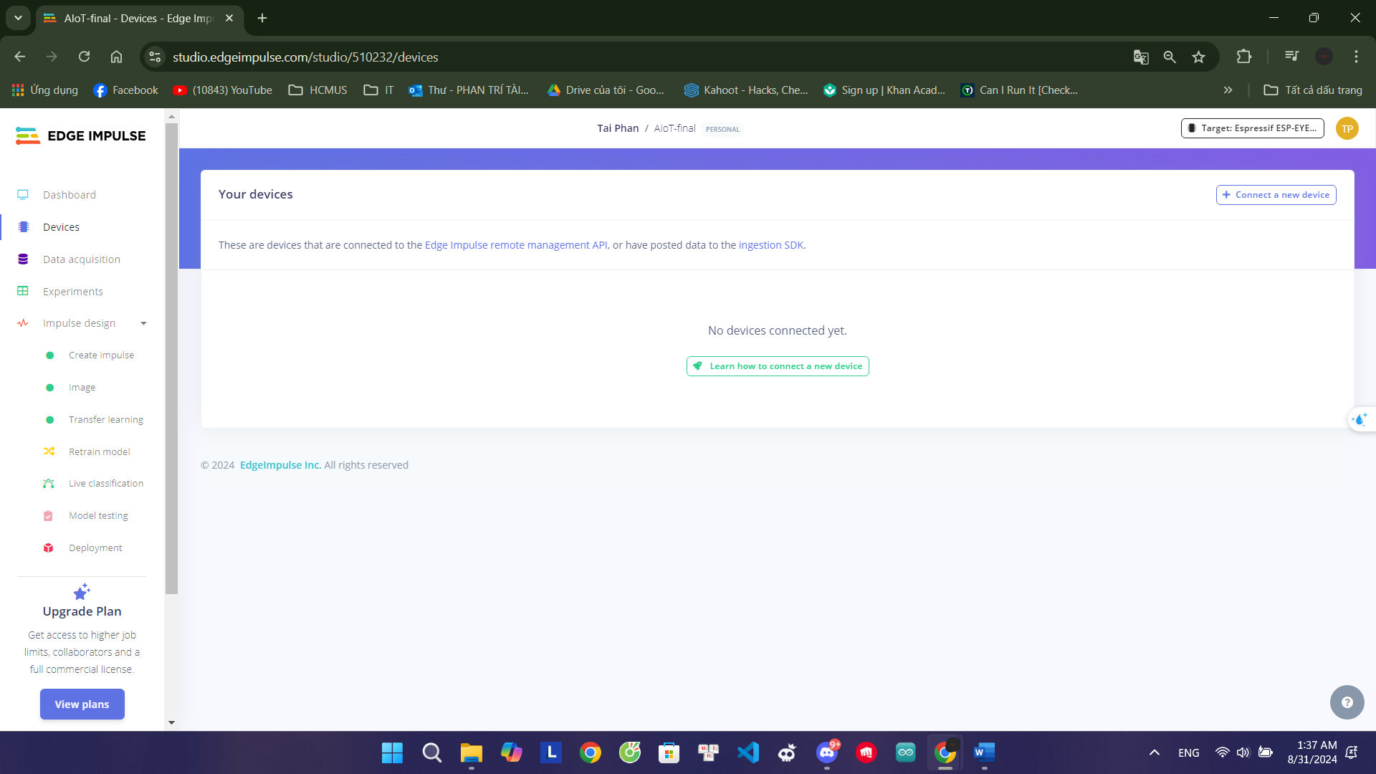
Step 1: Connect the device

Slide 10
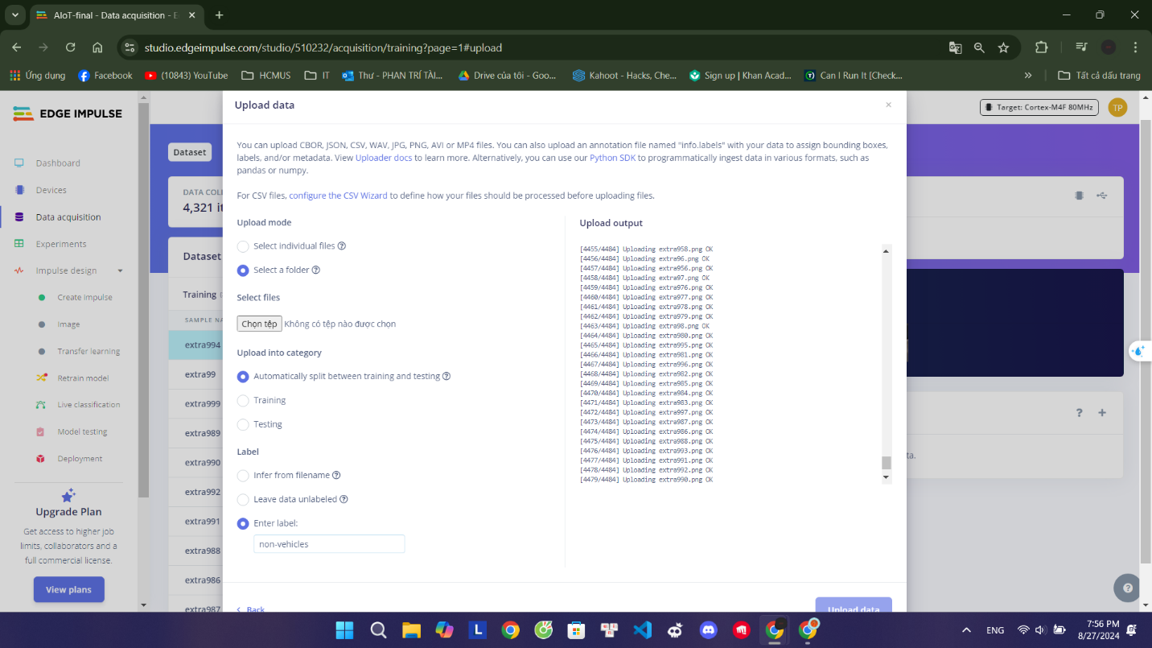
Step 2: Collect your first data
Non-vehicles data:

Slide 11
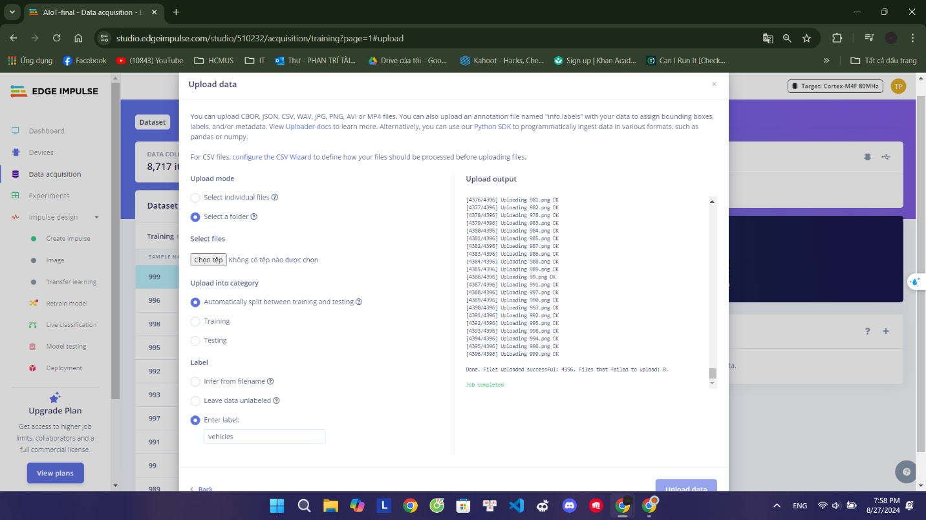
Step 2: Collect your first data
Vehicles data:

Slide 12
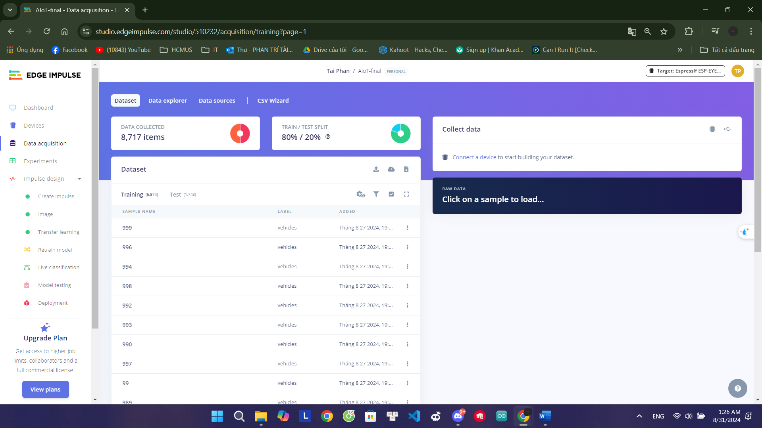
Step 3: Build the data set

Slide 13
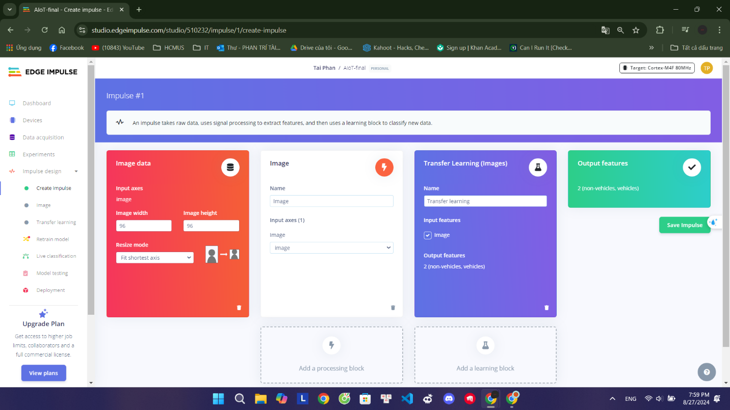
Step 4: Impulse design

Slide 14
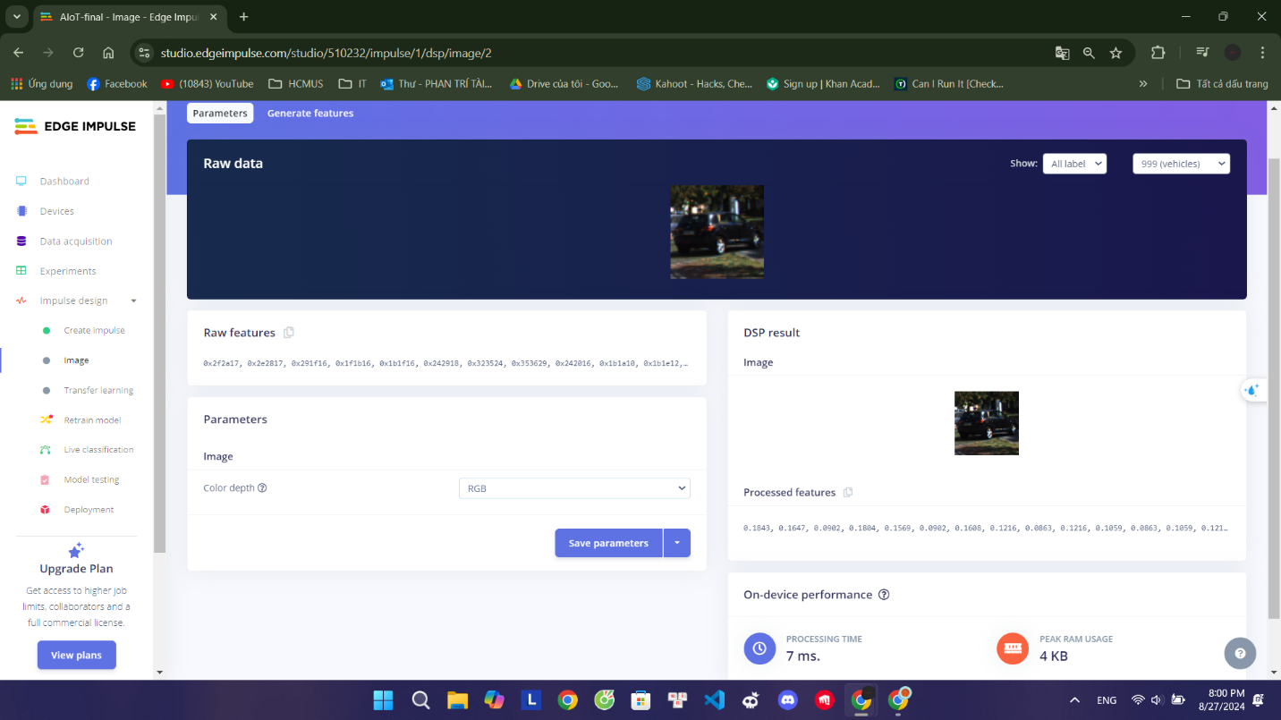
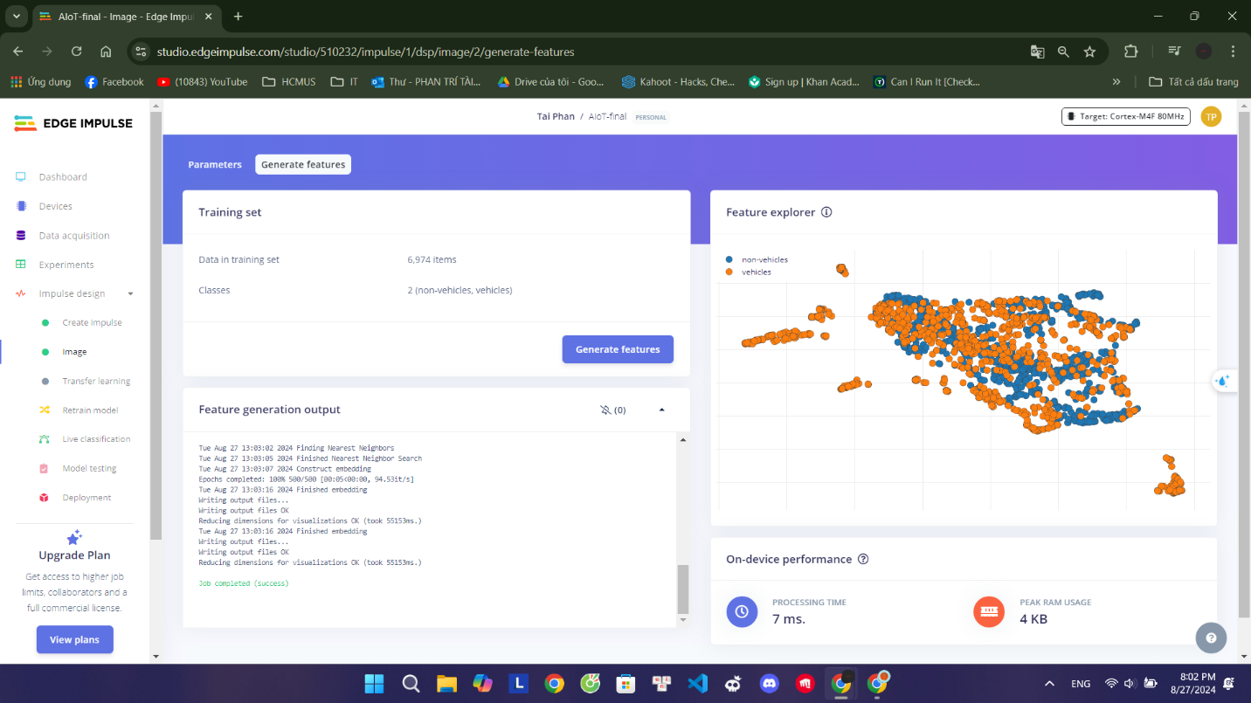
Step 5: Design the model
Image Processing:

Slide 15
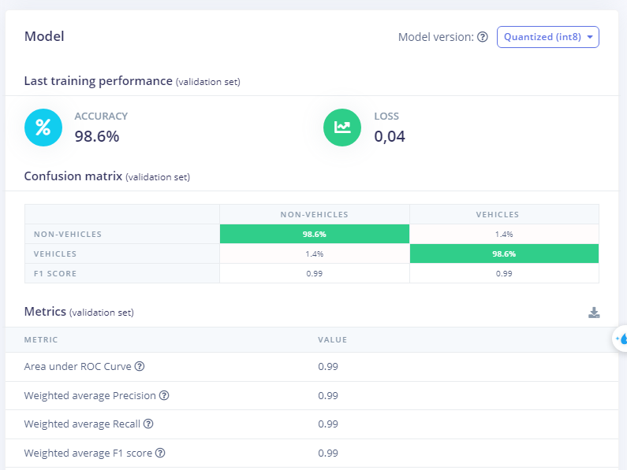
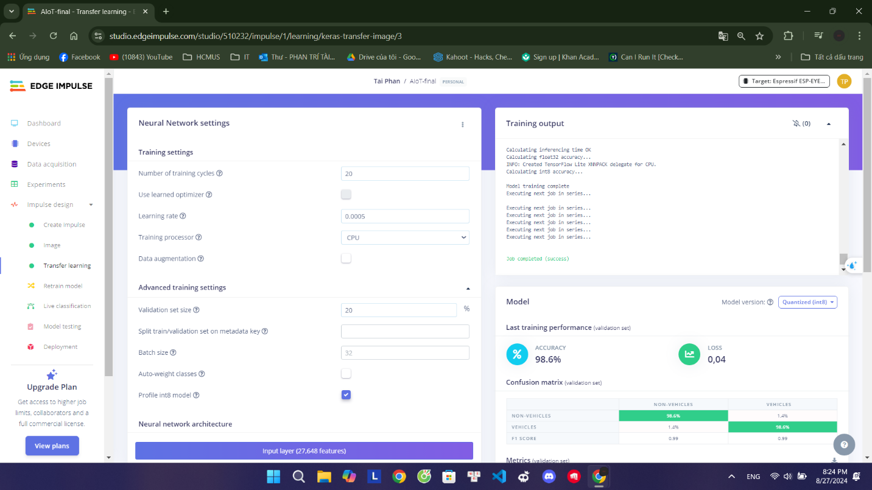
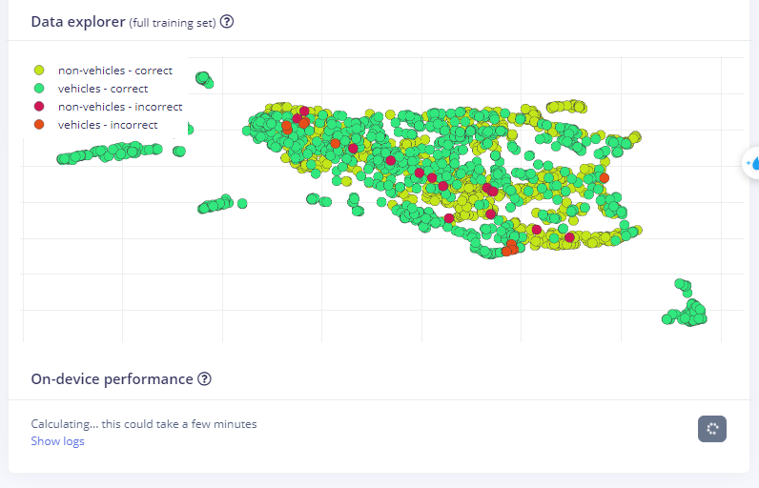
Step 5: Design the model
Transfer Learning:

Slide 16
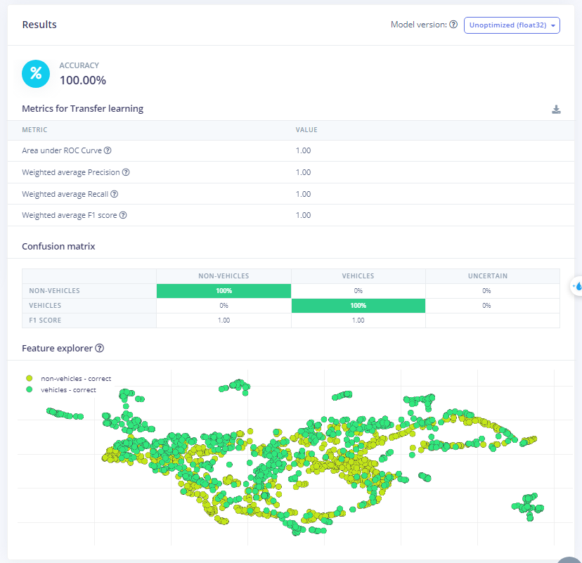
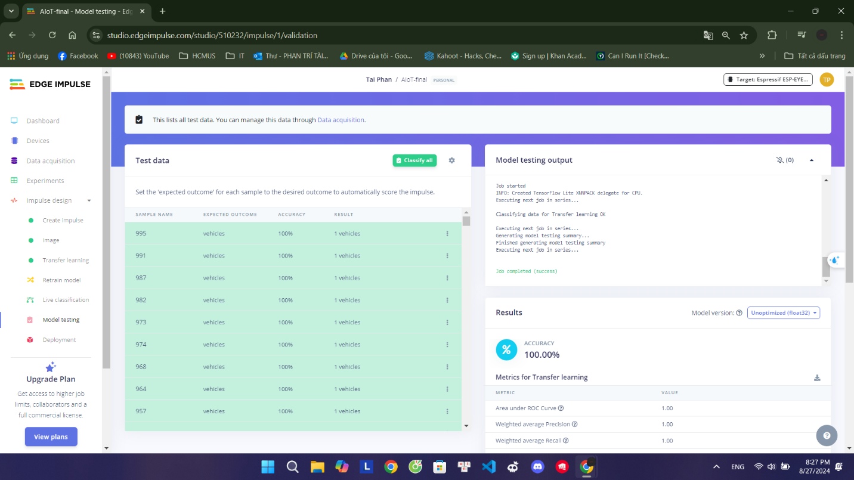
Step 6: Test the model

Slide 17
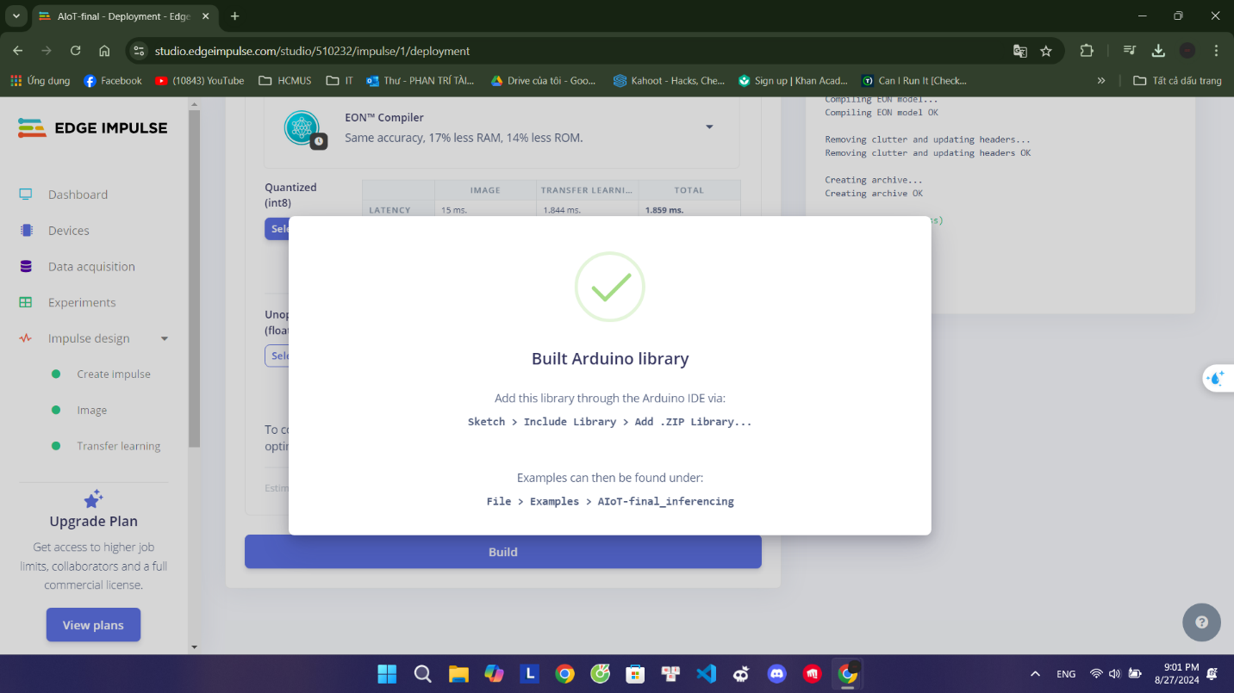
Step 7: Deploy to your device

Slide 18
04
Build on Arduino IDE

Slide 19
Thanks for watching

Slide 20
Thanks
Do you have any questions?
your email@freepik.com
+91 620 421 838 yourcompany.com

